Slide 1
Agile SCRUM Basics

Slide 2
Agile Scrum Overview
What is Scrum?
Values
Meetings
Commitment
Courage
Focus
Openness
Respect
Iterative & Incremental
Self-Organized
History of Scrum
Roles
Sprint Planning
Daily Scrum
Sprint Review
Sprint Retrospective
Backlog Refinement
Scrum of scrums
1986- Hirotaka & Ikujiro Introduced
1990- Ken Schwaber used Scrum
1995 – Sutherland & Schwaber
2001 – Schwaber & Mike Beedle -Agile Software Development with Scrum- Book released
2002- Scrum Alliance founded by Schwaber
2009 – Schwaber left from Scrum Alliance & founded Scrum.org
Product Owner
Development Team
Scrum Master

Slide 3





Project Life Cycle
Planned
Actuals
Project Conception/
Initiation
Close Project
Planning
Execution
Monitoring & Control
Planned
Project Charter
Project Management Plan
Status & Tracking
Vs.
Actuals
Risk
Resources

Slide 4
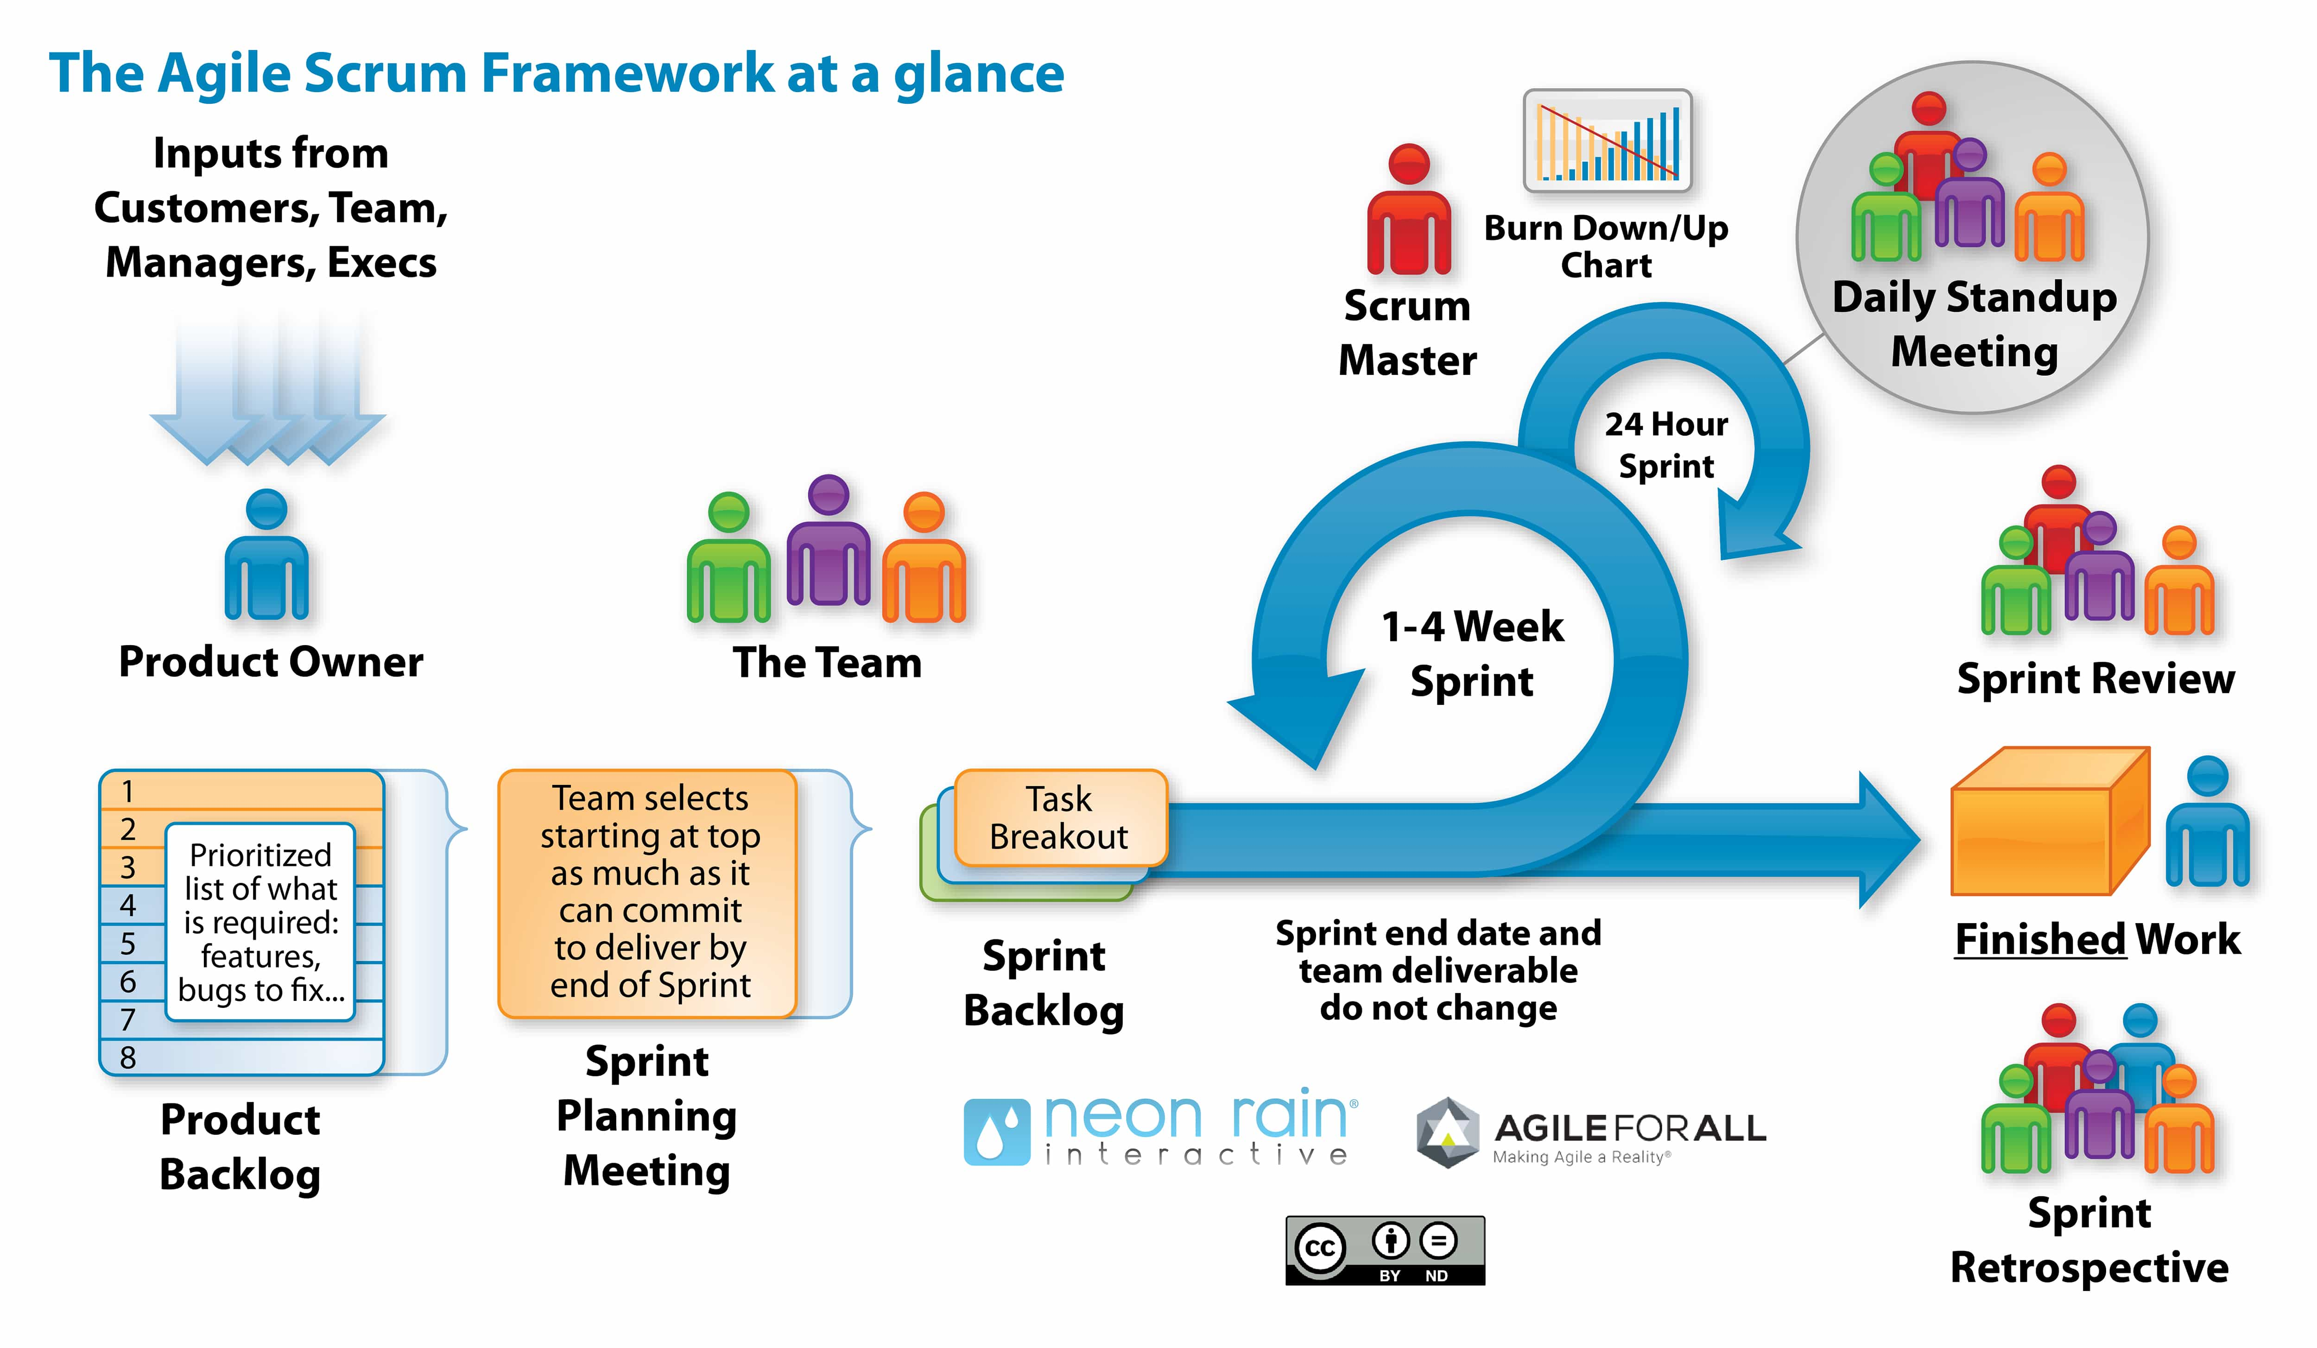

Slide 5
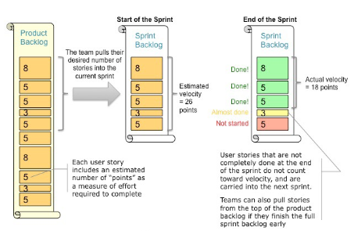
Velocity – is the Key Metric in Scrum

Slide 6
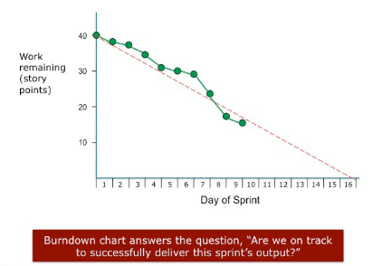
Burndown Chart

Slide 7
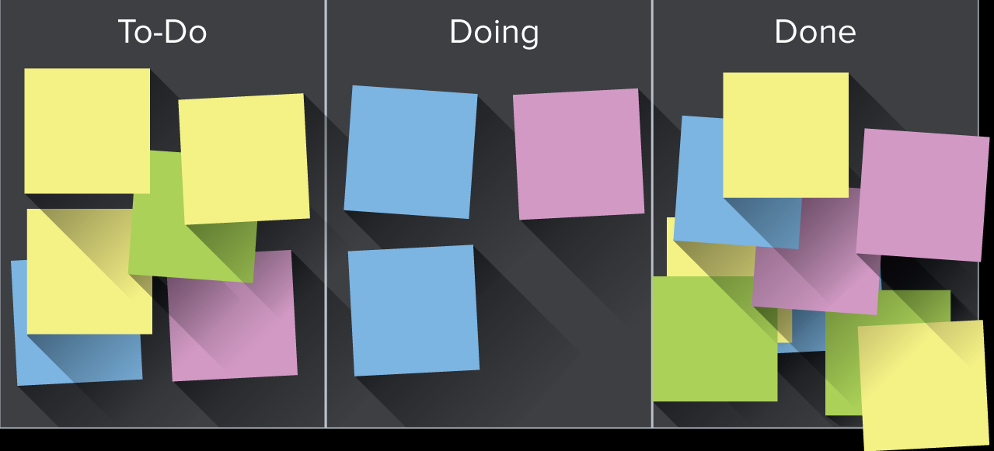
Project management - Kanban
Kanban is a visual signal that's used to trigger an action
Notes:
Kanban is a visual signal that's used to trigger an action. The word kanban is Japanese and roughly translated means “card you can see.” Toyota introduced and refined the use of kanban in a relay system to standardize the flow of parts in their just-in-time (JIT) production lines in the 1950s.

Slide 8




Project Management - Methodologies

Slide 9
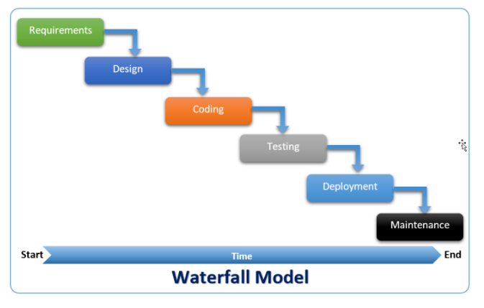
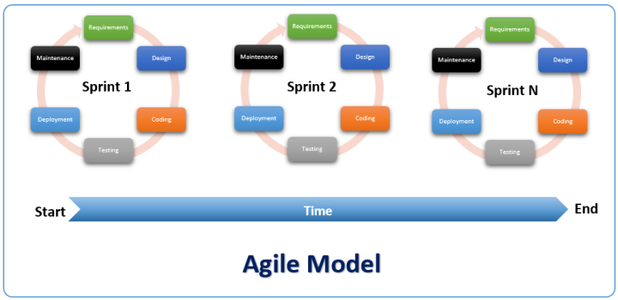
PLAN DRIVEN
CHANGE DRIVEN

Slide 10


The Agile Manifesto–a statement of values
Individuals and interactions
Process and tools
over
Working software
Comprehensive documentation
over
Customer collaboration
Contract negotiation
over
Responding to change
Following a plan
over
Source: www.agilemanifesto.org

Slide 11
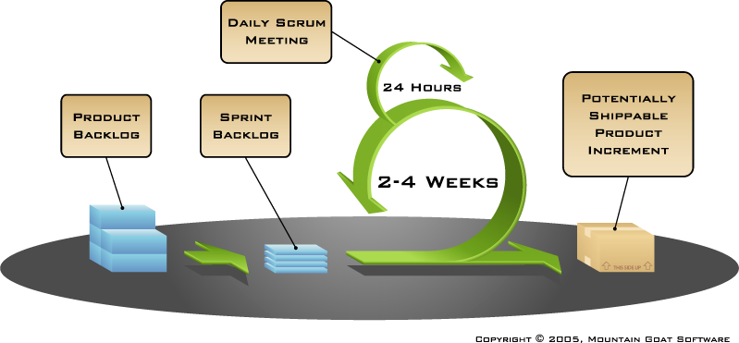
Putting it all together
Image available at www.mountaingoatsoftware.com/scrum

Slide 12
Sequential vs. Overlapping development
Requirements
Design
Code
Test
Rather than doing all of one thing at a time...
...Scrum teams do a little of everything all the time
Source: “The New New Product Development Game” by Takeuchi and Nonaka. Harvard Business Review, January 1986.

Slide 13
Scrum Framework
Roles
Product owner
ScrumMaster
Team
Ceremonies
Sprint planning
Sprint review
Sprint retrospective
Daily scrum meeting
Artifacts
Product backlog
Sprint backlog
Burndown charts

Slide 14
Scrum Framework
Roles
Product owner
ScrumMaster
Team
Ceremonies
Sprint planning
Sprint review
Sprint retrospective
Daily scrum meeting
Artifacts
Product backlog
Sprint backlog
Burndown charts

Slide 15

Product owner
Define the features of the product
Decide on release date and content
Be responsible for the profitability of the product (ROI)
Prioritize features according to market value
Adjust features and priority every iteration, as needed
Accept or reject work results

Slide 16

The Scrum Master
Represents management to the project
Responsible for enacting Scrum values and practices
Removes impediments
Ensure that the team is fully functional and productive
Enable close cooperation across all roles and functions
Shield the team from external interferences

Slide 17





The Team
Typically 5-9 people
Cross-functional:
Programmers, testers, user experience designers, etc.
Members should be full-time
May be exceptions (e.g., database administrator)

Slide 18
The Team
Teams are self-organizing
Ideally, no titles but rarely a possibility
Membership should change only between sprints

Slide 19
Scrum Framework
Roles
Product owner
ScrumMaster
Team
Ceremonies
Sprint planning
Sprint review
Sprint retrospective
Daily scrum meeting
Artifacts
Product backlog
Sprint backlog
Burndown charts

Slide 20


Team capacity
Sprint planning meeting
Sprint prioritization
Product backlog
Sprint
goal
Analyze and evaluate product backlog
Select sprint goal
Business conditions
Sprint planning
Decide how to achieve sprint goal (design)
Create sprint backlog (tasks) from product backlog items (user stories / features)
Estimate sprint backlog in hours
Current product
Sprint
backlog
Technology

Slide 21

Sprint planning
Team selects items from the product backlog they can commit to completing
Sprint backlog is created
Tasks are identified and each is estimated (1-16 hours)
Collaboratively, not done alone by the ScrumMaster
High-level design is considered
As a vacation planner, I want to see photos of the hotels.
Code the middle tier (8 hours)
Code the user interface (4)
Write test fixtures (4)
Code the foo class (6)
Update performance tests (4)

Slide 22
The Daily scrum
Parameters
Daily
15-minutes
Stand-up
Not for problem solving
Whole world is invited
Only team members, ScrumMaster, product owner, can talk
Helps avoid other unnecessary meetings

Slide 23

Everyone answers 3 questions
1
What did you do yesterday?
2
What will you do today?
3
Is anything in your way?
These are not status for the ScrumMaster
They are commitments in front of peers

Slide 24
The Sprint review
Team presents what it accomplished during the sprint
Typically takes the form of a demo of new features or underlying architecture
Informal
2-hour prep time rule
No slides
Whole team participates
Invite the world

Slide 25
Sprint Retrospective
Periodically take a look at what is and is not working
Typically 15–30 minutes
Done after every sprint
Whole team participates
ScrumMaster
Product owner
Team
Possibly customers and others

Slide 26

Start / Stop / Continue
Whole team gathers and discusses what they’d like to:
Start doing
Stop doing
This is just one of many ways to do a sprint retrospective.
Continue doing

Slide 27
Scrum framework
Roles
Product owner
ScrumMaster
Team
Ceremonies
Sprint planning
Sprint review
Sprint retrospective
Daily scrum meeting
Artifacts
Product backlog
Sprint backlog
Burndown charts

Slide 28

Product backlog
The requirements
A list of all desired work on the project
Ideally expressed such that each item has value to the users or customers of the product
Prioritized by the product owner
Reprioritized at the start of each sprint
This is the product backlog

Slide 29
A Sample product backlog
Backlog item | Estimate
Allow a guest to make a reservation | 3
As a guest, I want to cancel a reservation. | 5
As a guest, I want to change the dates of a reservation. | 3
As a hotel employee, I can run RevPAR reports (revenue-per-available-room) | 8
Improve exception handling | 8
... | 30
... | 50

Slide 30
The Sprint goal
A short statement of what the work will be focused on during the sprint
Life Sciences
Support features necessary for population genetics studies.
Database Application
Make the application run on SQL Server in addition to Oracle.
Financial services
Support more technical indicators than company ABC with real-time, streaming data.

Slide 31
Managing the sprint backlog
Individuals sign up for work of their own choosing
Work is never assigned
Estimated work remaining is updated daily

Slide 32
Managing the sprint backlog
Any team member can add, delete or change the sprint backlog
Work for the sprint emerges
If work is unclear, define a sprint backlog item with a larger amount of time and break it down later
Update work remaining as more becomes known

Slide 33
A sprint backlog
Tasks
Mon
Tues
Wed
Thur
Fri
Code the user interface
8
4
8
Code the middle tier
16
12
10
4
Test the middle tier
8
16
16
11
8
Write online help
12
Write the foo class
8
8
8
8
8
Add error logging
8
4

Slide 34

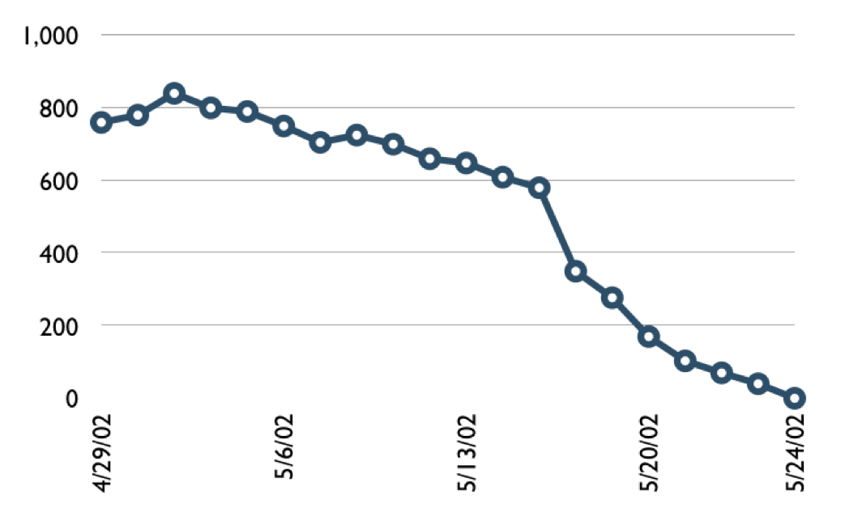
A sprint burndown chart
Hours

Slide 35
Tasks
Mon
Tues
Wed
Thur
Fri
Code the user interface
8
4
8
Code the middle tier
16
12
10
7
Test the middle tier
8
16
16
11
8
Write online help
12
50
40
30
Hours
20
10
0
Mon
Tue
Wed
Thu
Fri

Slide 36
Scalability
Typical individual team is 7 ± 2 people
Scalability comes from teams of teams
Factors in scaling
Type of application
Team size
Team dispersion
Project duration
Scrum has been used on multiple 500+ person projects

Slide 37






Scaling through the Scrum of scrums

Slide 38
Scrum of scrums of scrums

Slide 39
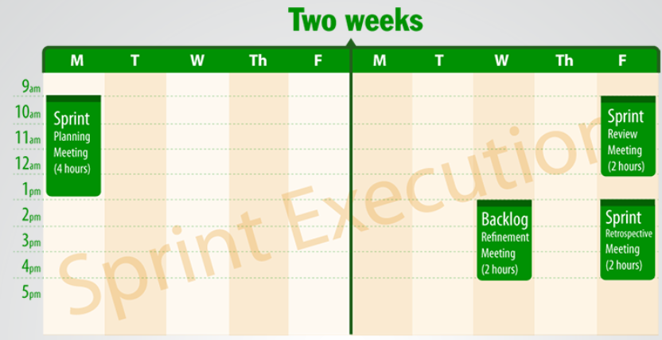
SCRUM Meetings (2 weeks Sprint)
Sprint Planning Meeting- 4 – 8 Hours
Daily Scrum Meeting – 15 Minutes
What I did yesterday?
What I will today?
Impediment
Sprint Review Meeting – 1 – 2 Hours. Live demo
Sprint Retrospective Meeting – 2 Hours
Find the cause , not people
Backlog Refinement Meeting – 2 Hours

Slide 40
SCRUM Artifacts
Product Backlog
The product backlog comprises an ordered list of requirements that a Scrum Team maintains for a product.
Sprint Backlog
The Sprint Backlog is the list of work the Development Team must address during the next Sprint.
Product Increment
The increment (or potentially shippable increment, PSI) is the sum of all the Product Backlog Items completed during a Sprint, integrated with the work of all previous Sprints.
Sprint burn-down chart
The Sprint burn-down chart is a public displayed chart showing remaining work in the Sprint Backlog. Updated every day, it gives a simple view of the Sprint progress.
Release burn-up chart
The release burn-up chart is a way for the team to provide visibility and track progress toward a release. Updated at the end of each Sprint, it shows progress toward delivering a forecast scope.

